Slide 1
People Like Us: STEM careers slides Find keywords in notes section under each slide, matched to STEM & careers at KS2-3. For further support please visit https://peoplelikeus.io/about-us or email PLU@fujitsu.co.uk

Slide 2
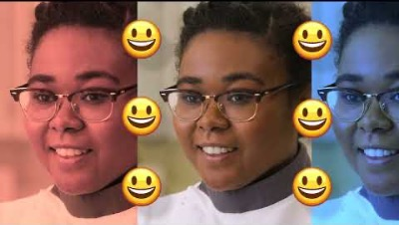
Cleo, Tissue Culture Scientist
Creating artificial skin to test cosmetics & medicines
Thinking creatively outside the box
I create skin as an alternative to animal testing
More black female role models now
Do YOU!
Stay true to yourself
I squashed my nerdiness
Biomedical materials science at uni
Cleo…
Notes:
CURRICULUM-MAPPING
STEM: parts of the body, cells, tissue, microscopes, ethics, animal testing
Careers: A levels, degree, diversity, creativity, academic ambition

Slide 3
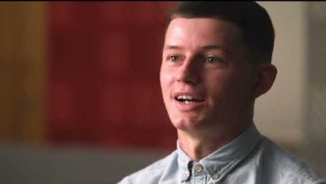
Reece, Lead App Designer
Creating phone and web apps that are slick and fun to use.
I am really REALLY enjoying it
I do my bit of magic!
I bought my own house, aged 21
Class clown…I got suspended from school
Mash-up of tech and creativity
Stumbled across degree apprenticeships
Reece…
Notes:
CURRICULUM-MAPPING
STEM: computer coding, designing apps, display technology
Careers: Degree apprenticeship, problem-solving

Slide 4
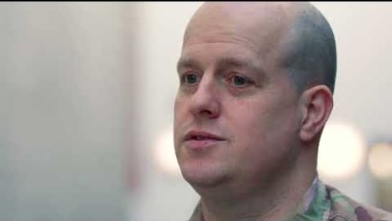
James, tech developer
Creates immersive VR programs to help train people from anywhere
Become the better you
Move to UK at 12 was tough
RAF understood my learning difficulties
I taught myself to code using YouTube
I work at Technology Innovation Centre
360 degree immersion in VR training
James…
Notes:
CURRICULUM-MAPPING
STEM: virtual reality, coding, interface
Careers: Apprenticeship, international, SEND

Slide 5
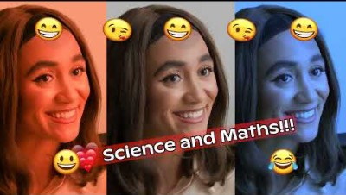
India, road engineer
Designs road systems to keep people moving
Be part of the change
I work with a lot of other women engineers
I’m a practical learner
Apprenticeship after school
Blend of on-the-job and off-the-job
Innovation requires creativity
India…
Notes:
CURRICULUM-MAPPING
STEM: computer-aided design, engineering, sustainable travel, materials, composites, forces, motion, speed, friction
Careers: Apprentice, civil engineering, good salary, work experience, creativity, practical learner, gender diversity

Slide 6
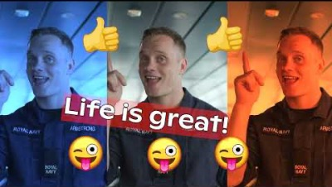
Stuart, ocean mapper
Sails the oceans with the Royal Navy, mapping the sea-bed
I went to the Arctic – a dream become real!
Mapping underwater mountains
Every day I’m learning something new
Royal Navy helped me get a degree
I’m proud of what I’ve done
ADHD, dyslexia…
Stuart…
Notes:
CURRICULUM-MAPPING
STEM: rocks, water, forces, climate, assessing risk, sonar, density, pressure
Careers: Degree sponsored by employer, SEND, international travel

Slide 7
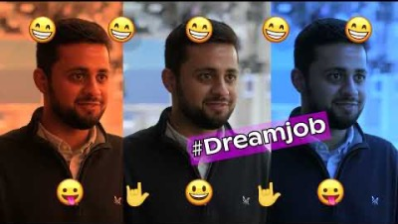
Jahangir, TV studio supremo
Brings TV shows from location into homes
Filming football matches
Broadcast engineer
Sky, One Show, BAFTAs, ITV
Shy at school, lacked confidence, NOT A-grade
Degree apprenticeship with BBC
Learning alongside BBC engineers
Jahangir…
Notes:
CURRICULUM-MAPPING
STEM: satellites, colour, light, optical fibres, control processes
Careers: Degree apprenticeship sponsored by BBC; a variety of placements, not A/A*, learning from others

Slide 8
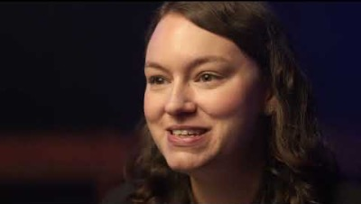
Michelle, rollercoaster designer
Took her love of theme parks and turned it into a job
I love what I do
SO MUCH!
Designing theme park rides
Civil engineering degree
Love teams – different roles working together
Weekend hobby turned into a career!
I founded my own business!
Michelle…
Notes:
CURRICULUM-MAPPING
STEM: energy conservation, light, sound, gravity, forces, motion, friction, design, health and safety
Careers: Degree in civil engineering, passion, creativity, business owner, teamwork, gender diversity

Slide 9
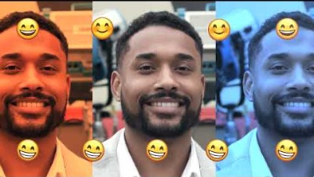
Rem, makes TV shows
Creating top shows from behind the camera
Producing films & TV for BBC & Amazon
I was excluded but new school was fresh start
We need different voices at every level
Create TV shows form planning to audience
Loved drama and IT at school.
Started in script-writing
Rem…
Notes:
CURRICULUM-MAPPING
STEM: power in circuits, series and parallel, light, sound, control, electronic systems
Careers: Excluded from school but found passion, apprenticeship with BBC, several different roles, diversity

Slide 10
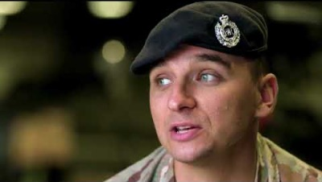
Jonathan, camo comms wizard
Telecommunication engineer connecting battlefield vehicles
Life lessons I can teach my kids.
Travel to broaden mind, with Army
Take things apart – bike, computer...
Command & control on battlefield
Alien at first,
soon becomes second nature
Using GPS to track army vehicles
Jonathan…
Notes:
CURRICULUM-MAPPING
STEM: motion, satellites, GPS, electromagnetic waves, magnetic compass
Careers: Career with army for travel, escape unhappy home, always learning

Slide 11
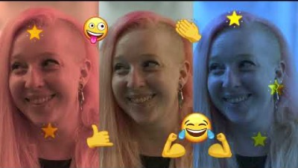
Cate, virus-buster
A cat-and-mouse battle with germs hijacking cells, including COVID
Think a degree is a waste of time?
You’ll turn 21 anyway!
Scientists can have piercings & pink hair!
I can be myself; I have autonomy
Teacher predicted me E, I got A* - that showed him!
Using my brain to do something important
I work with petri dishes, viruses, bacteria, white blood cells…
Cate…
Notes:
CURRICULUM-MAPPING
STEM: disease, infection, viruses, bacteria, genome, inheritance, microbiology techniques, health and safety - biohazards
Careers: Motivated by initial failure, break during 6th form, high grades, Cambridge University (first from school), PhD.

Slide 12
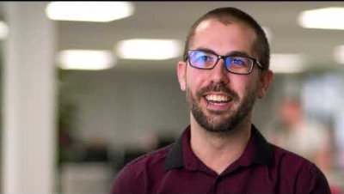
Tom, network fixer
Loves everything that works on data – phones, shopping, gaming
I see the
Mona Lisa
in a firewall
School is a fish tank; life is the ocean
I modified my x-box to get internet – that got me hired!
I didn’t learn to read
Meeting other nerds was a revelation
I had no confidence at school
Tom…
Notes:
CURRICULUM-MAPPING
STEM: designing and building circuits, series, parallel, current, voltage, resistance, soldering, static, optical fibres
Careers: Apprenticeship, overcame failure at school, confidence boost, so many options within STEM

Slide 13
We’d love your feedback: https://bit.ly/PLU_feedback Any questions or ideas? Email PLU@fujitsu.co.uk

