Slide 2
STEM Careers
Information for teachers:​
People Like Us (https://peoplelikeus.io) is a free online resource featuring STEM careers role models and is aimed at students aged 9-14.​
There are 11 people featured, from ordinary backgrounds, who have found a job they love in STEM. Many of them overcame difficulties in their school or home life.​
We hope that there are people here that your students will feel they can identify with, and perhaps learn something more about potential careers in STEM.​

Slide 3
STEM Careers
Instructions for teachers:
The learning activity should take about 30 minutes and can be done in school or at home.
Each student needs access to the internet – on a computer, tablet or phone – ideally on their own, but can be in pairs.
The Student Worksheet can be printed, sent to students electronically or read aloud (it is reproduced on the following slides) and their answers can be written on the sheet, jotted down on a separate piece of paper or provided verbally.
There are some correct answers (see Teacher Answer Sheet) but the important thing is that they engage with the resource for at least 30 minutes.

Slide 4
Worksheet page one
To answer the questions below you will need to visit the People Like Us website at: https://peoplelikeus.io
Watch Jacob’s introduction and then play the game.
What was your score on your first attempt at the game? / 5

Slide 5
Worksheet page one
Now meet the crew by choosing “Meet People Like Us” from the menu.
Choose 3 people that look interesting to meet and spend 10 minutes getting to know them.
Then answer the questions about those 3 people:

Slide 6
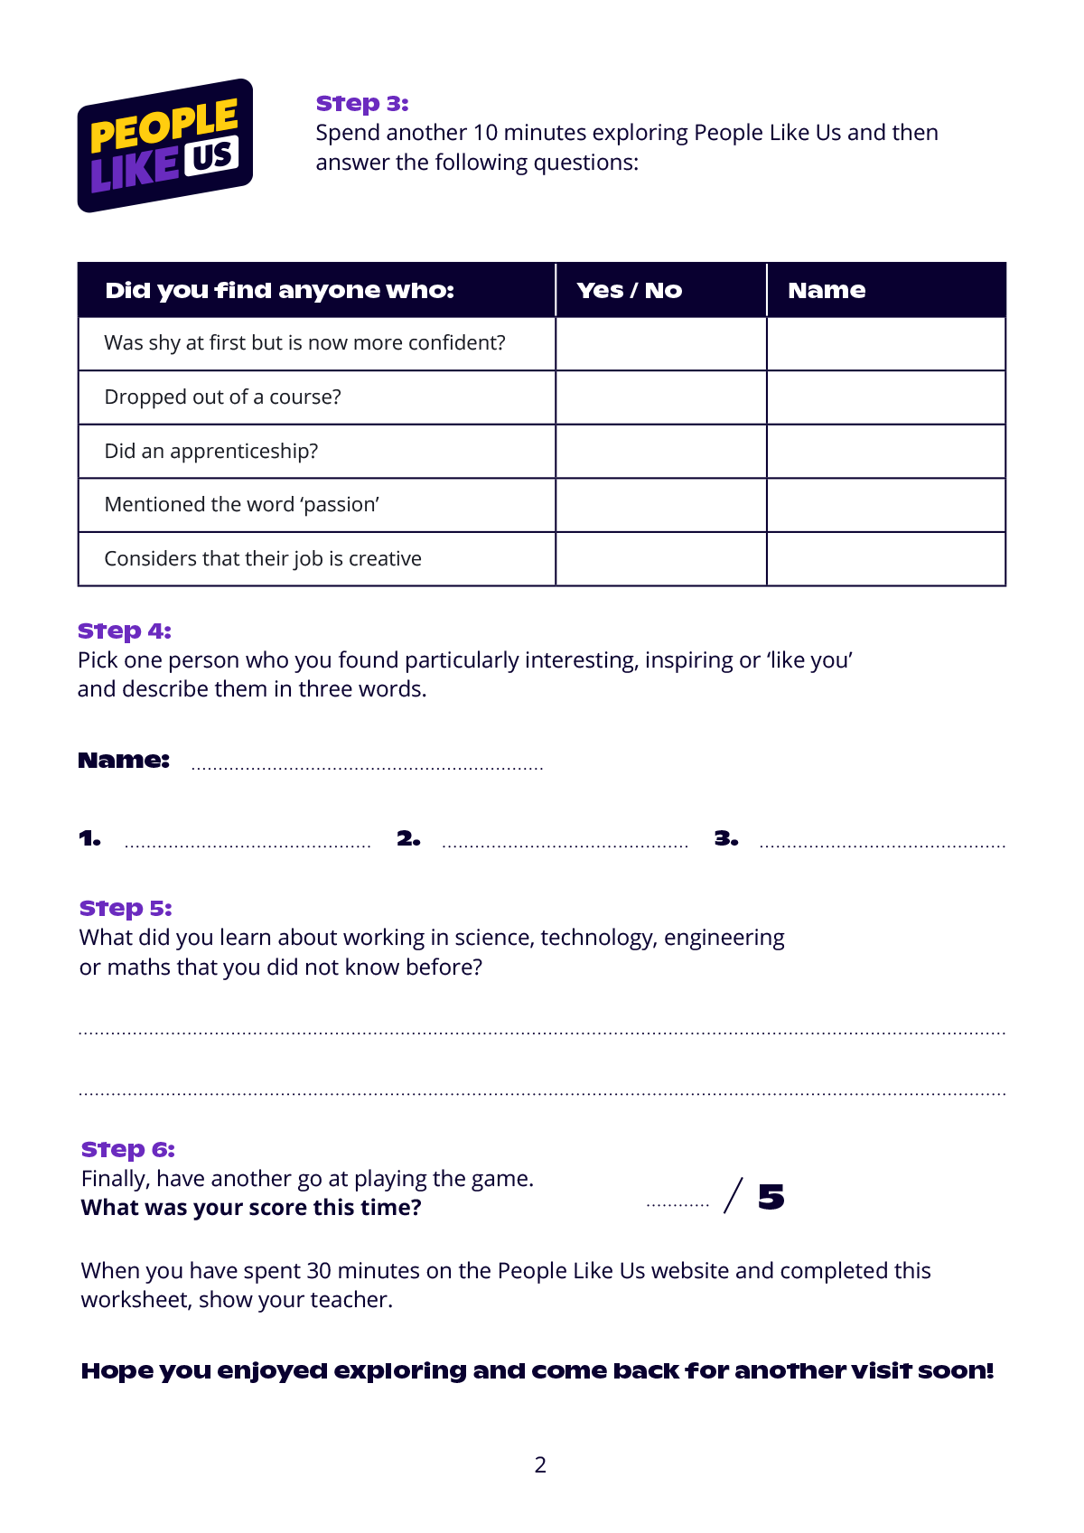
Worksheet page two
Now spend another 10 minutes exploring People like us and then answer the questions.
Pick one person who you found particularly interesting or ‘like you’ and describe them in three words.
What did you learn about working in science, technology, engineering or maths that you did not know before?
Finally, have another go at playing the game. See what score you get this time.

